Slide 1

MODULE – 4 Information Visualization & Text Search Algorithms

Slide 2
Topics to be covered
Visualization
Cognition and Perception
Naïve Pattern Searching Algorithm
Knuth Morris Pratt(KMP) Algorithm
Boyer Moore Algorithm

Slide 3
Visualization
Visualization is the process of representing data in a visual and meaningful way so that a user can understand it.
Visualization allows users to draw insights from abstract data in an efficient and effective manner.
It also helps to grab the attention of users.

Slide 4
Functionalities of Information Visualization
Modifies the representation of data
Use same representation while showing changes in data
Animate the display to show the changes in space and time
Enable interaction to allow dynamic moment
ex: Google assistant ,HCI(Human Computer Interface)
Create hyperlinks

Slide 5
Cognition and Perception
Cognition is the mental action or process of acquiring knowledge and understanding through thought, experiences and senses.
Ex: Thinking how to solve a particular mathematics problem

Slide 6
Perception is organization, identification and interpretation of sensory information. Intuition based on cognition is called perception
Ex: looking at letters on a page(sensation)
interpreting them as our favorite passage in a novel(perception)

Slide 7
Under Cognition and Perception :
Proximity : Grouping of nearby figures.
Similarity : Grouping of similar figures.
Continuity : figures are interpreted as smooth continuous patterns rather than discontinuous concatenation of shapes.
Closure : gaps in a figure are filled in to create a whole.
Connectedness : uniform and linked spots, lines or areas are perceived as a single unit.

Slide 8
Visualization technologies
The main aspect of visualization is to improve user interaction.
The various visualization technologies are :
Preattention :
Having prerequisite knowledge or prior knowledge on things which we want to know.
2. Optical illusion :
It refers to visualizing things in different manner.

Slide 9
3. Hue , Saturation , Lightness(colors) :
Hue - refers to shades of the colors
Saturation – changing the shades of original color
Lightness – refers to brightness and contrast to improve quality of picture
4. Configurable aspects of display :
Preattention, optical illusion ,hue ,saturation and lightness all combined together for better display is called configurable aspects of display.

Slide 10
5. Spatial Frequency :
A measure of how often sinusoidal components of the structure repeat per unit of distance.
Simply it refers to image analysis.
6. Human sensory system :
It refers to how user respond to changes in different components or things.

Slide 11
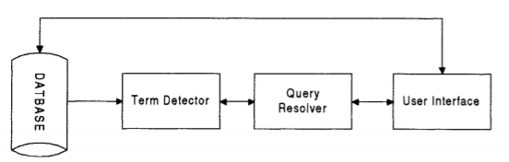
Text Search Techniques
The concept of text scanning system is the ability to for one or more users to enter queries with the text of items to be searched sequentially accessed and compared to query terms.
Text streaming architecture

Slide 12
Naïve Pattern Searching Technique
Simplest method among other pattern searching algorithms.
It checks for all character of the main string to the pattern.
This algorithm is helpful for smaller texts.
We can find substring by checking once for the string.
Does not occupy extra space to perform the operation.

Slide 13
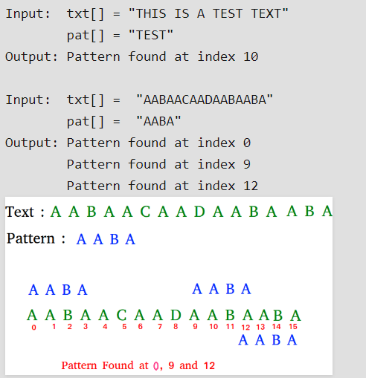
Consider an example -
Given a text txt[0..n-1] and a pattern pat[0..m-1],
assume n>m

Slide 14
It checks with 1st character of text with 1st character of pattern ,if it is not matched it goes to 2nd character and continue till it is matched.
It requires “m*n” times of execution i.e O(mn)

Slide 15
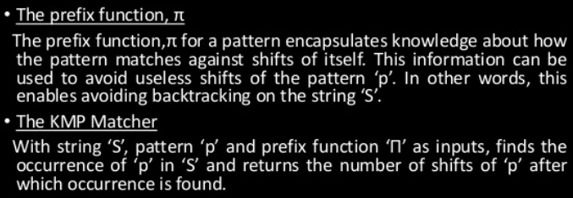
Knuth Morris Pratt(KMP) Algorithm
Knuth Morris Pratt (KMP) is an algorithm, which checks the characters from left to right.
Backtracking on the string 'S' never occurs
Components of KMP –

Slide 16
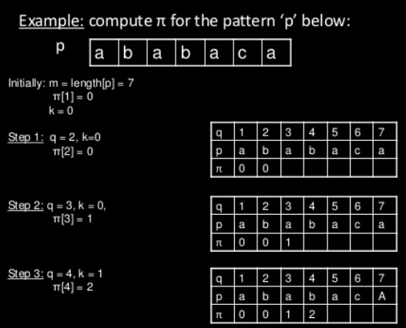

Slide 17
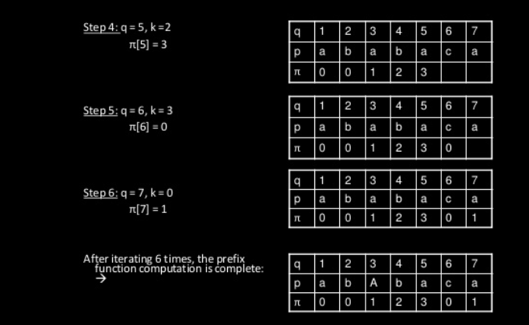

Slide 18
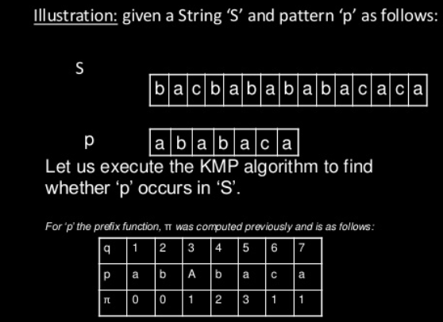

Slide 19
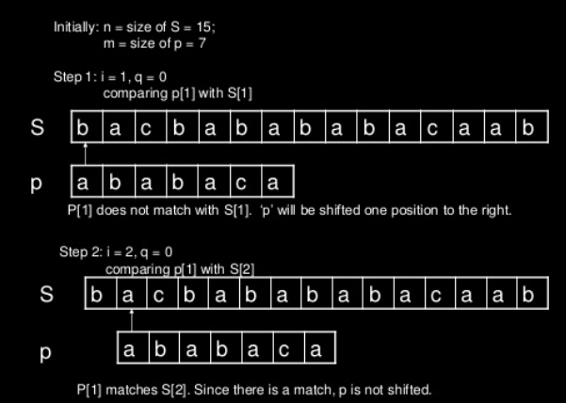

Slide 20
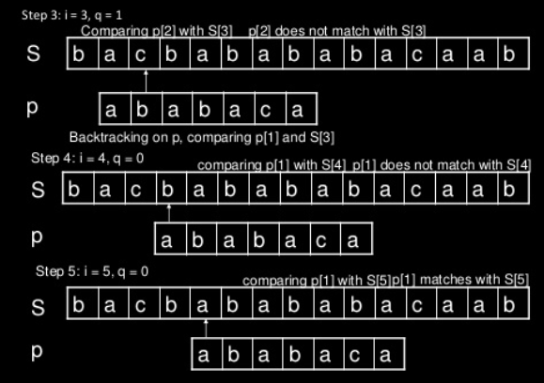

Slide 21
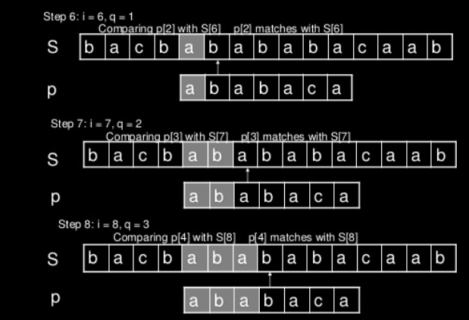

Slide 22
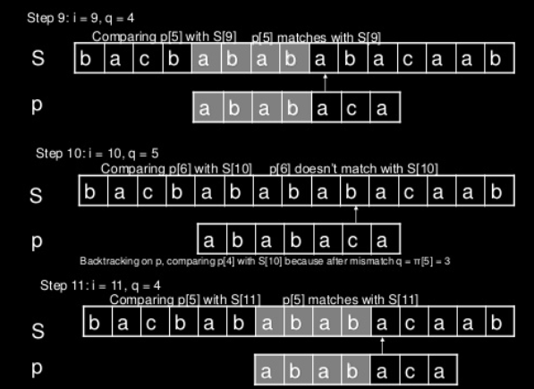

Slide 23
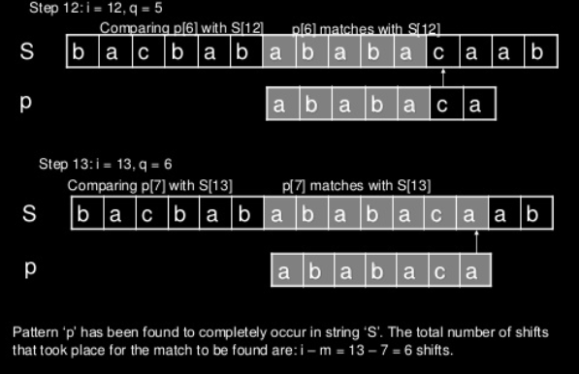

Slide 24
Boyer Moore Algorithm
This algorithm scans the pattern from right to left i.e beginning from the rightmost character.
Steps to find the pattern :
Construct bad match table
Align the pattern against the beginning of the text
Repeat the steps until matching substring is found or pattern reaches the last character of the text.

Slide 25

Formula for constructing bad match table :

Slide 26
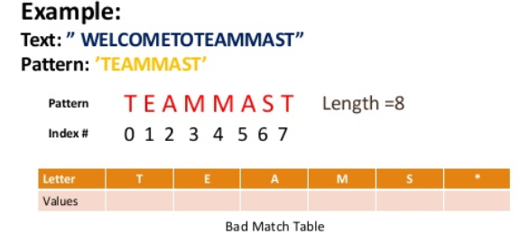
Consider an example

Slide 27
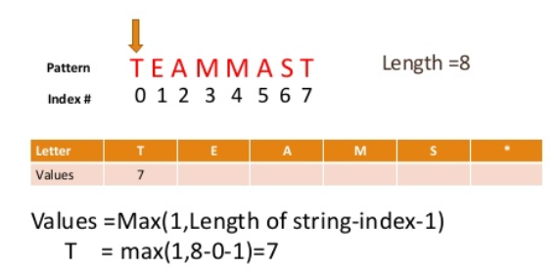
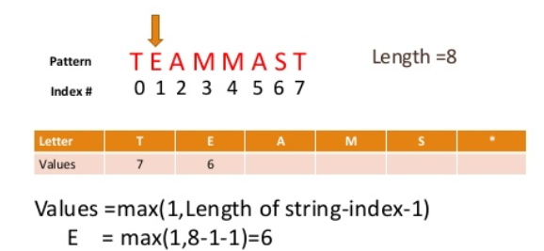

Slide 28
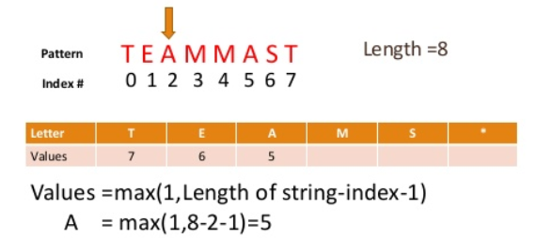
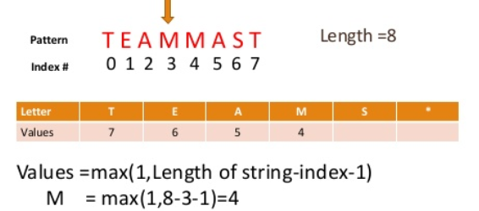

Slide 29
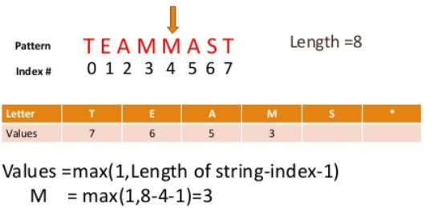
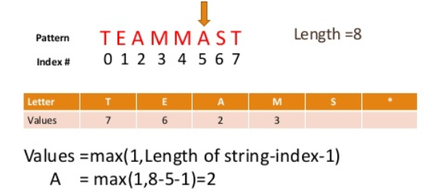

Slide 30
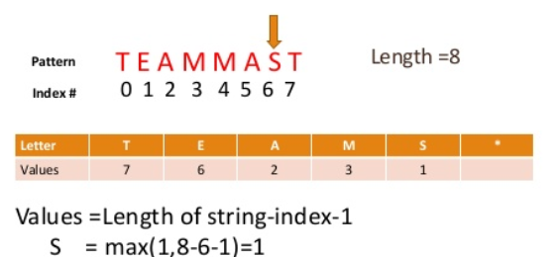
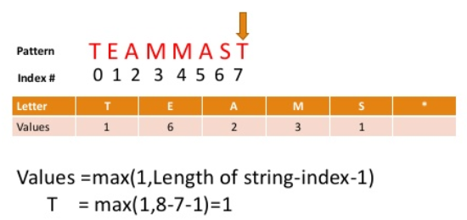

Slide 31
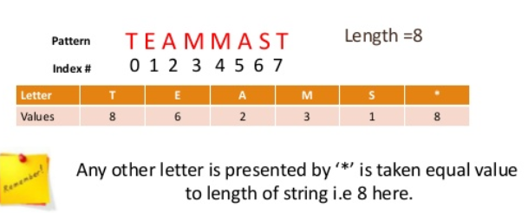
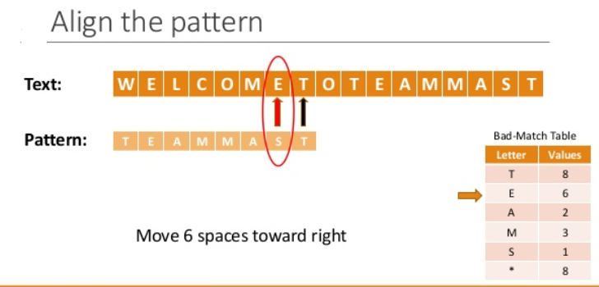

Slide 32
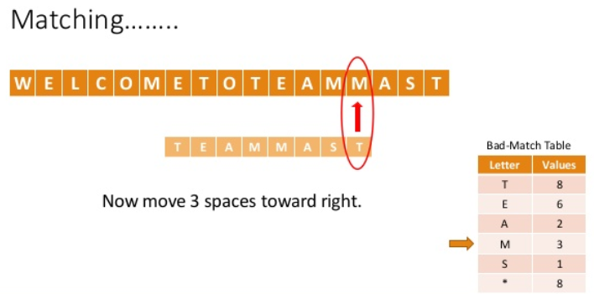
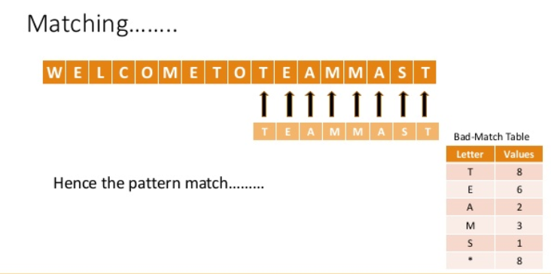

Slide 33
THANK YOU!

